Slide 1

Custom module development

Slide 2
Drupal 8 a lot has changed
With the release of Drupal 8 a lot has changed. Drupal 7 primarily relies on procedural PHP code whereas Drupal 8 is mostly object oriented. To get to grips with some of the fundamentals of Drupal 8 we’re going to create a custom module, register a menu router item within said module and finally output some rendered markup on the page.

Slide 3
Object Oriented PHP
Drupal 8 has adopted the latest best practices for PHP. It uses PHP 5.4+, Classes and Interfaces, Namespaces, Traits, Dependency Injection, and conforms to the PSR-4 standards for file paths to autoload classes. Drupal 8 is built on top of several proven Symfony 2 modules and utilizes several other libraries such as PHPUnit, Composer, and jQuery. To create modules, themes, blocks and more you will now need to use classes and new info files in YAML.

Slide 4
Drupal 8 : For Developers
Drupal 8 has switched its templating engine to Twig from PHPTemplate which has a more friendly syntax for designers. HTML5 Forms are also included which means mobile users can be displayed a variety of keyboards for different types of input. Some of the new fields include Date, Email, Link, Reference, and Telephone.

Slide 5
Custom module development
As Drupal 8 is object oriented and enforces PSR-4 standards, the way you make modules has significantly changed. However, this change makes modules much more organized to fit today’s coding practices.
This PSR describes a specification for autoloading classes from file paths. It is fully interoperable, and can be used in addition to any other autoloading specification, including PSR-0. This PSR also describes where to place files that will be autoloaded according to the specification.
PSR-4 does not convert underscores to directory separatorsYou cannot use PSR-4 if you do not use namespaces

Slide 6
Creating our module folder
In Drupal 7 sites core modules are located in the root directory of your site in a sub-folder called “modules”. In Drupal 8 these core modules have now moved to “core/modules”. What this means to us the developer is that the “modules” that was once out of bounds can be used freely.

Slide 7
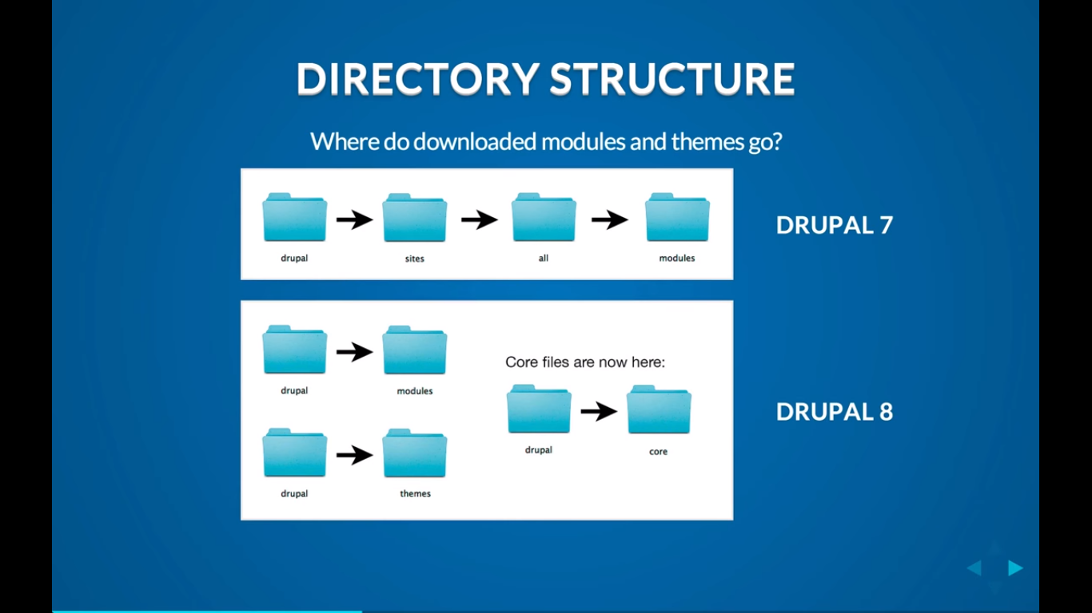

Slide 8
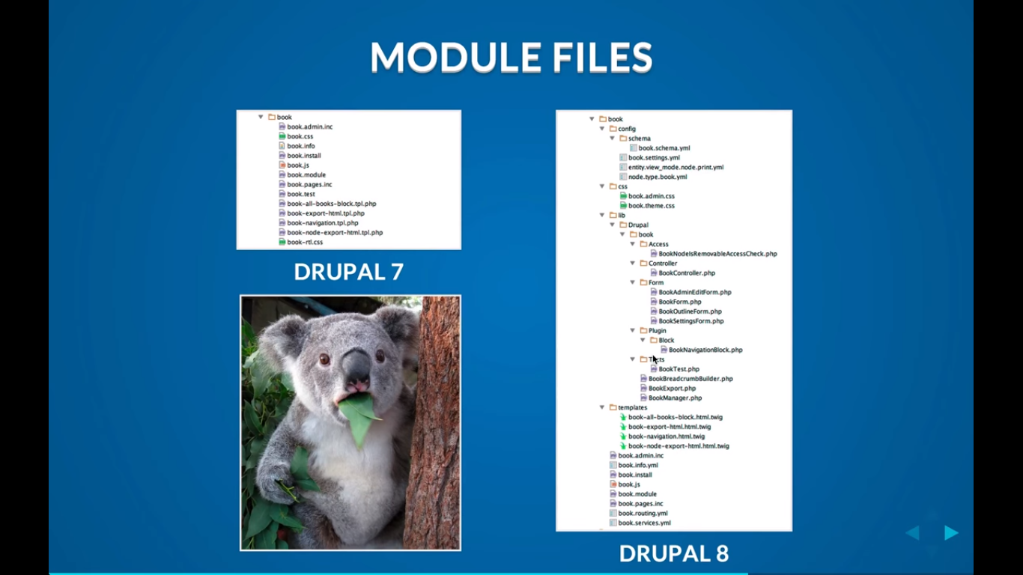

Slide 9
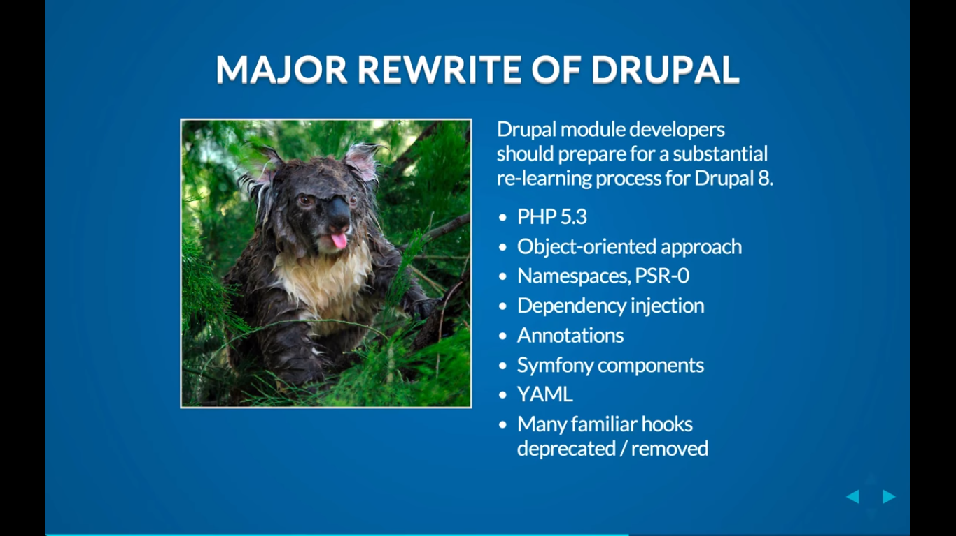

Slide 10
Drupal Module Development
Extend core functionality
Core module
Contributed module
Custom module

Slide 11
Basic required files
<module name>.info.yml (module information)
<module name>.module ( all the functions ,logics
<controller name>.php (Controler File)

Slide 12
Basic required function
HOOKS
hooks are php function that alter modify default functions
Example :hook_menu, hook_block_info, hook_block_view, hook_install

Slide 13
Example Hooks
Hook Name Drupal Function
hook_node_load Loading a node from database
hook_form_alter Allows altering forms
hook_user_login User has just logged in

Slide 14
Drupal 8 Custom Module
Why make a module?
• Contribute to Drupal.org
• Functions to reuse between sites
• Functions specific to a site
• Learn to debug contrib and core
• Learn how other modules work

Slide 15
What should you know?
• PHP programming
• Object Oriented Programming
• Basic functions of Drupal!
• Experience with some modules

Slide 16
Let's make a module!!

Slide 17
Create Module Folder
• /modules/rnotices
• or.....
• /modules/custom/rnotices

Slide 18
Create Module Files
• In /modules/custom/rnotices...
• rnotices.info.yml
• rnotices.module

Slide 19
*.info.yml Files
• Replaces .info file
• Tells Drupal about your module

Slide 20
rnotices.info.yml
name: Role Notices
type: module
description: 'Display notices per role.'
package: Demo
core: 8.x

Slide 21
*.module file
• Contains PHP Functions
• Needs opening <?php tag
• Needed even if empty(still?)

Slide 22
To the Code!
Hello World Example

